Slide 1


Airflow Data pipelines
Ismael Cabral

Slide 2


About me, Ismael Cabral
Background: Msc Sustainable tech / Data Science
6 years as Data Scientist / Machine Learning Engineer
Now: Machine Learning Engineer at Xebia Data
Currently working on the second edition of “Data Pipelines with Apache Airflow”

Slide 3
About YOU
Background?
What do you think Airflow does?
Plans to apply Airflow?
How many DAGs have you written?

Slide 4

Program
Day 1
Day 2
What is Airflow?
Installation
Your First DAG
Scheduling
Context & Templating
Branching & TriggerRules
Sensors
Scheduling & Backfilling
DAG configuration
Variables, Xcoms & Connections
Finish Capstone Project

Slide 5
Learning Goals
Learn fundamental concepts: DAGs, Operators, Hooks
Know your way around the Airflow UI
Know a little about how Airflow works internally
Be able to debug errors

Slide 6

Airflow
The big picture

Slide 7
Open-source platform for creating, scheduling and monitoring workflows
Started at AirBnB in 2015
Now used by 200+ companies (ING, LinkedIn, Paypal, HBO, …)
Contributions from 600+ developers
Licensed under the Apache License 2.0, for free use and distribution.
What is Apache Airflow?

Slide 8


Scenario: We are working on a weather forecast data pipeline for a new app
Requirements:
Run daily
One geographical location
Get Data from external API
Load raw data into DB
Outlier
Removal
Store into forecast table
Permission changes
Code-errors
Memory overflow
Many things can go wrong
No data
Auth-errors
No connectivity
API-changes
Schema changes
API not available
Rate-limits
Data format change

Slide 9
Good news! The forecast app is scaling
Requirements:
Run hourly
100 geographical locations
Get Data from external API
Load raw data into DB
Outlier
Removal
Store into forecast table
Get Data from external API
Load raw data into DB
Outlier
Removal
Store into forecast table
Get Data from external API
Load raw data into DB
Outlier
Removal
Store into forecast table
Get Data from external API
Load raw data into DB
Outlier
Removal
Store into forecast table
Get Data from external API
Load raw data into DB
Outlier
Removal
Store into forecast table
Get Data from external API
Load raw data into DB
Outlier
Removal
Store into forecast table
How do you keep track of?
Schedule over different timezones
The status of your pipeline
Tasks failed
Manage changes / failure
Insightful Logging
Overall Performance
Get Data from external API
Load raw data into DB
Outlier
Removal
Store into forecast table
Get Data from external API
Load raw data into DB
Outlier
Removal
Store into forecast table
Get Data from external API
Load raw data into DB
Outlier
Removal
Store into forecast table
Get Data from external API
Load raw data into DB
Outlier
Removal
Store into forecast table

Slide 10






Airflow is the orchestrator of your data pipelines
Airflow Scheduler coordinates that your tasks are “played” when they are needed
Airflow lets you write instructions in Python. So you have the right instruments to perform your tasks
Airflow UI gives an overview of what is going good and bad in the “playbook”
The organized logs stream brings clarity on the history of the runs

Slide 11
Airflow is not a (data) processing framework (such as Spark).
Implementing highly dynamic / changing pipelines.
Airflow focusses on orchestration and monitoring
Not for streaming data solutions
When NOT to use Airflow

Slide 12

Directed Acyclic Graph
AKA: Nodes with directed flow and no loops
Task A
Task B
Task D
Task C

Slide 13
Operators
They define and execute tasks within workflows
BashOperator: Executes a bash command or script.
PythonOperator: Runs a Python function as a task.
EmailOperator: Sends an email notification.
Action Operators
Transfer Operators
FileTransferOperator: Transfers files between different locations or systems.
SQLTransferOperator: Transfers data between databases using SQL queries.
S3ToRedshiftOperator: Loads data from Amazon S3 into Amazon Redshift.
Sensor Operators
HttpSensor: Polls an HTTP endpoint until it returns a successful response.
S3KeySensor: Waits for a specific key or file to be available in Amazon S3.
TimeSensor: Pauses the workflow until a specific time or time interval is reached.

Slide 14
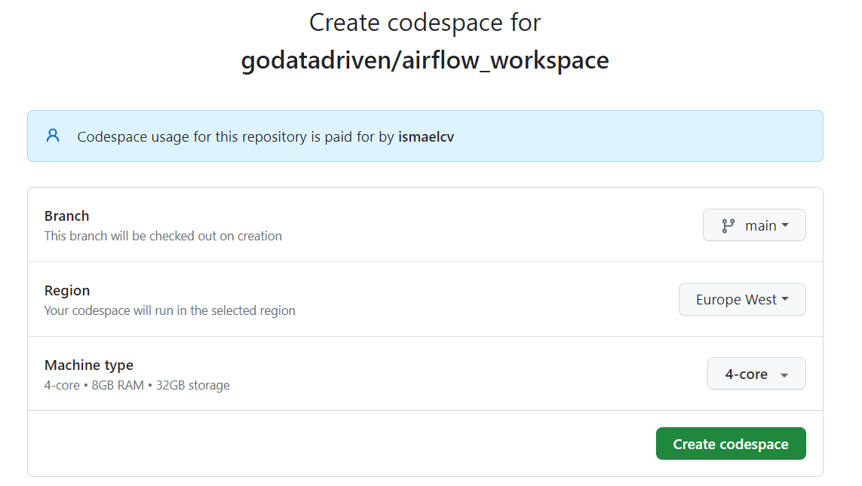
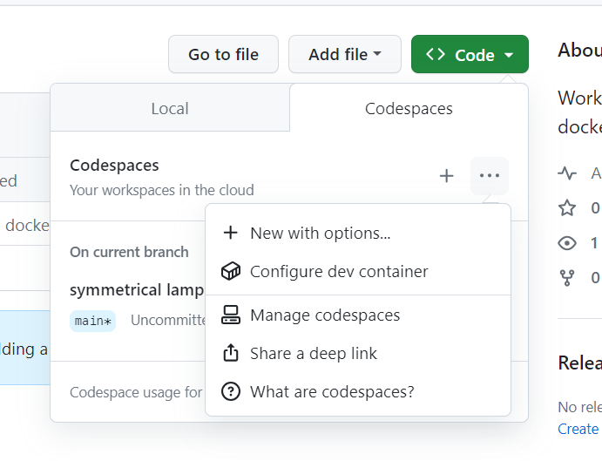
Airflow Installation
Fork Repo: https://github.com/godatadriven/airflow_workspace
Select:
Code > … > + New with options …
Select:
4-core > Create codespace

Slide 15
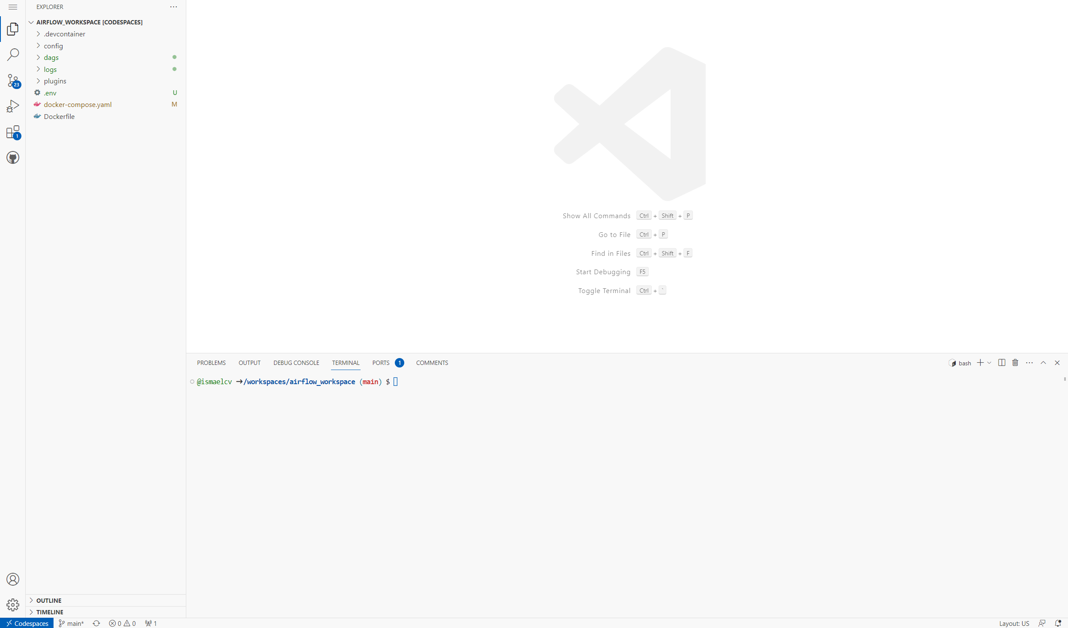
VS Code Web environment.
This will be your workspace for the rest of this training
In the terminal (ctrl + ` ) check you have more than 4GB of allocated memory:
docker run --rm "debian:bullseye-slim" bash -c 'numfmt --to iec $(echo $(($(getconf _PHYS_PAGES) * $(getconf PAGE_SIZE))))
(ONLY RUN ONCE) You need to run database migrations and create the first user account. It is all defined in the docker compose file so just run:
docker compose up airflow-init
Now you can start all services:
docker compose up
airflow-init_1 | Upgrades done
airflow-init_1 | Admin user airflow created
airflow-init_1 | 2.6.1 start_airflow-init_1
exited with code 0
outputs
http://0.0.0.0:8080
Airflow UI

Slide 16





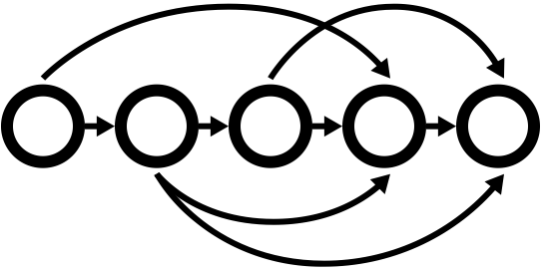

Airflow engine. Orchestrate the tasks
executes the task logic defined in the operator
DB
Webserver
Scheduler
Worker
UI with useful metrics
Stores metadata of all runs
DAGs
Logs
Express dependencies between tasks
Core
Components
Monitor Execution of workflows
Check all the Airflow components in the console with:
docker ps
Hint

Slide 17

Capstone Project:
You are a rocket scientist for a day (or two)!

Slide 18
Airflow UI
Walkthrough

Slide 19
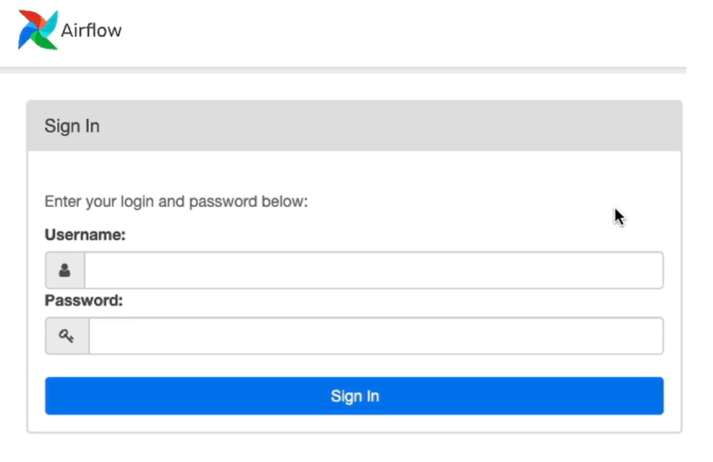
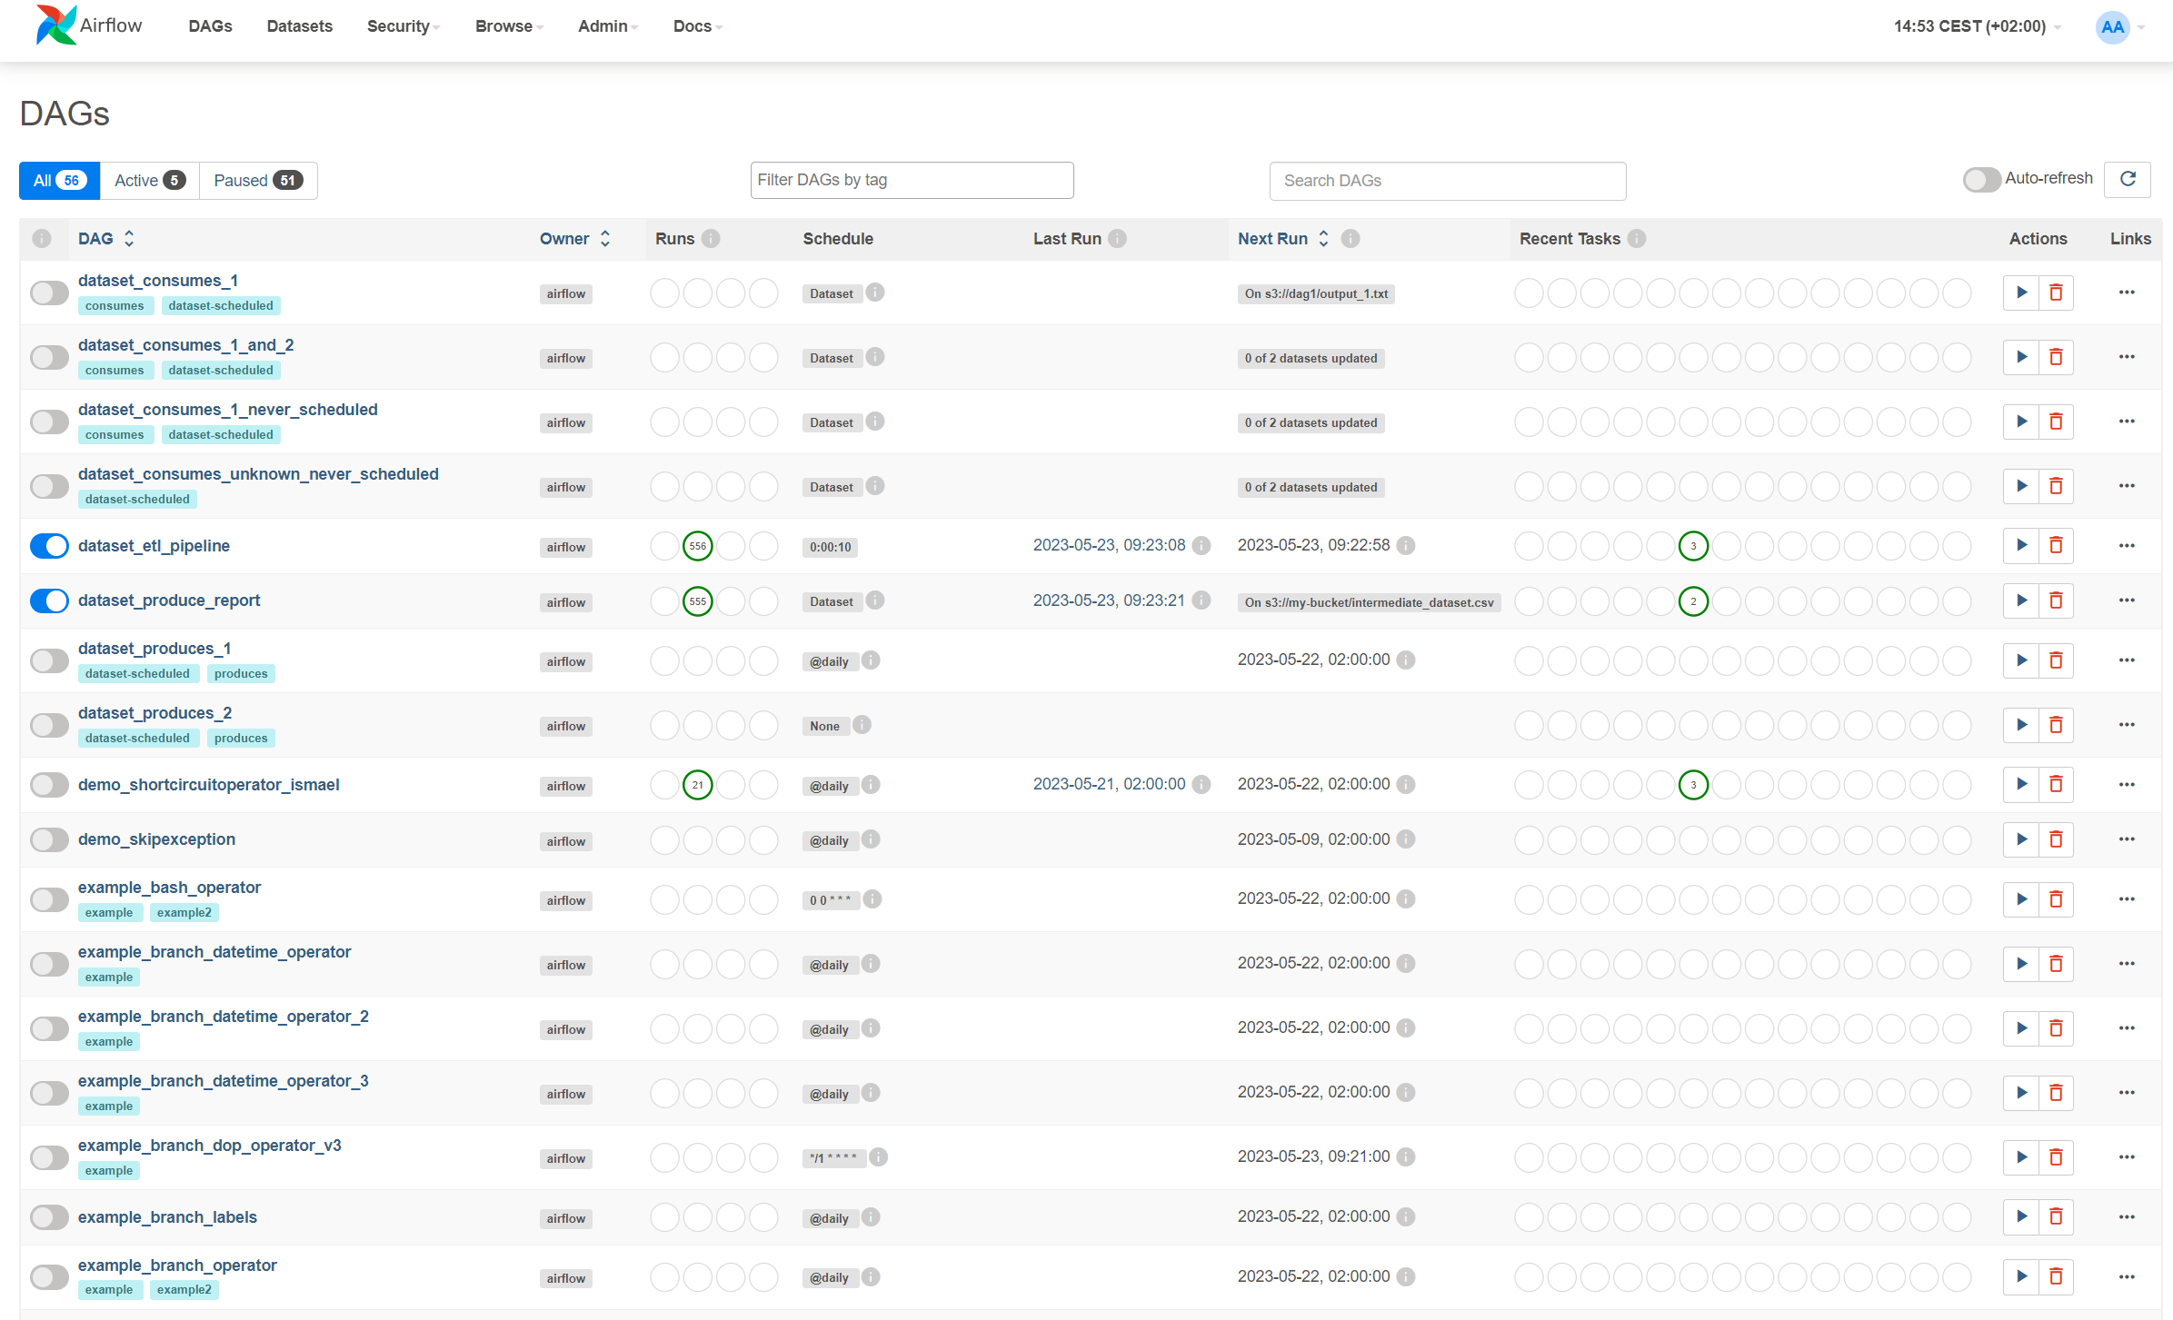
Localhost:8080/
DAG View
airflow
airflow
List all the DAG’s in the Airflow Instance
Tags
Schedule
Run information
Delete
Pause/ Unpause Dags

Slide 20
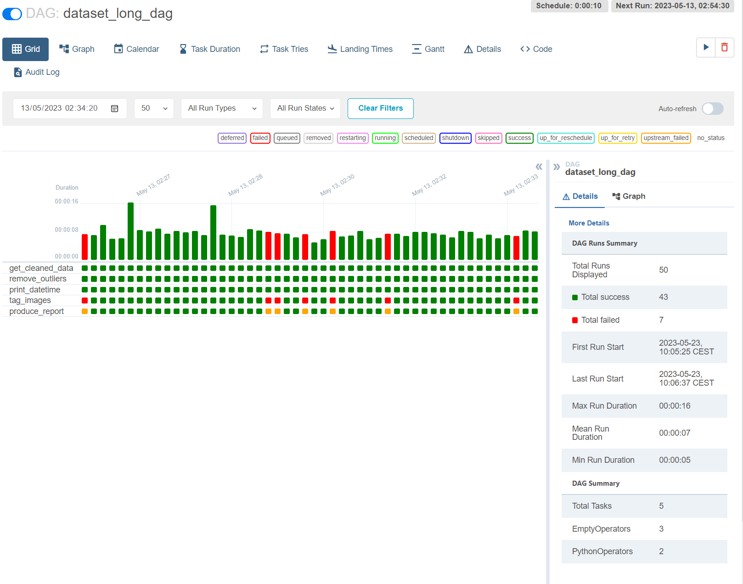
Grid View
The state of your DAG runs
Wide view of all the Runs
If you see all green, you stop worrying
If you see yellow / red you can go deeper to review what happened
Details the state of each task per run
Total Success / Fail tasks
Duration per run
Task metadata (Name, id, etc)

Slide 21
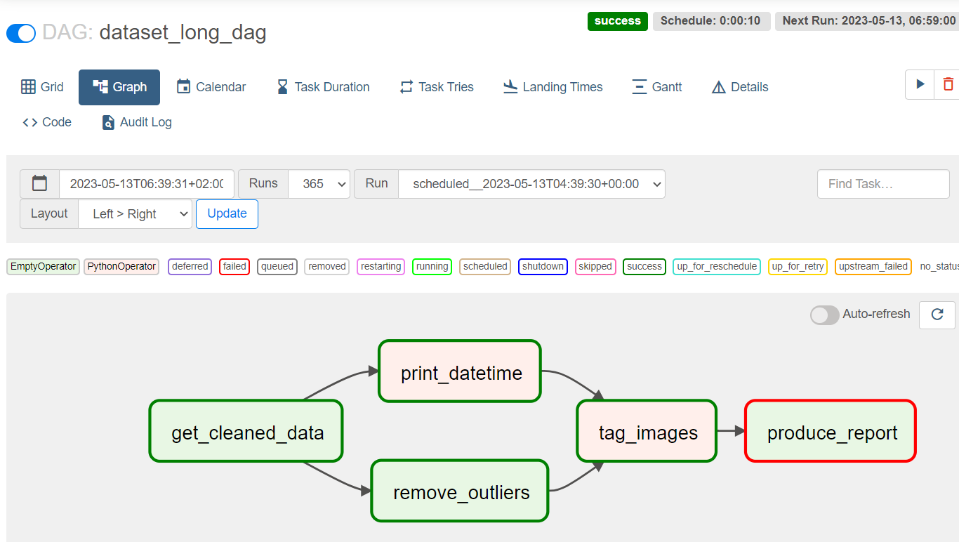
Graph view
Logical Sequence of your DAG
You can see how tasks depend on each other
What kind of operators do we have by color filling
Status of each task by color edge
Verify task dependencies are correct

Slide 22
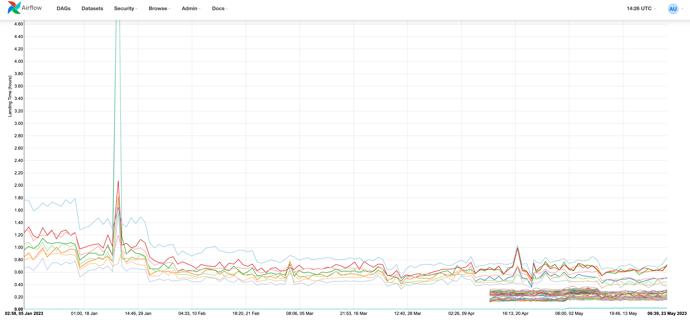
Landing times
Measures Schedule time vs Realized time
Overall view of your system performance
Identify periods in time when there was a task failure
See how task duration is improving (or degrading) over time
Identify when new tasks have been added

Slide 23
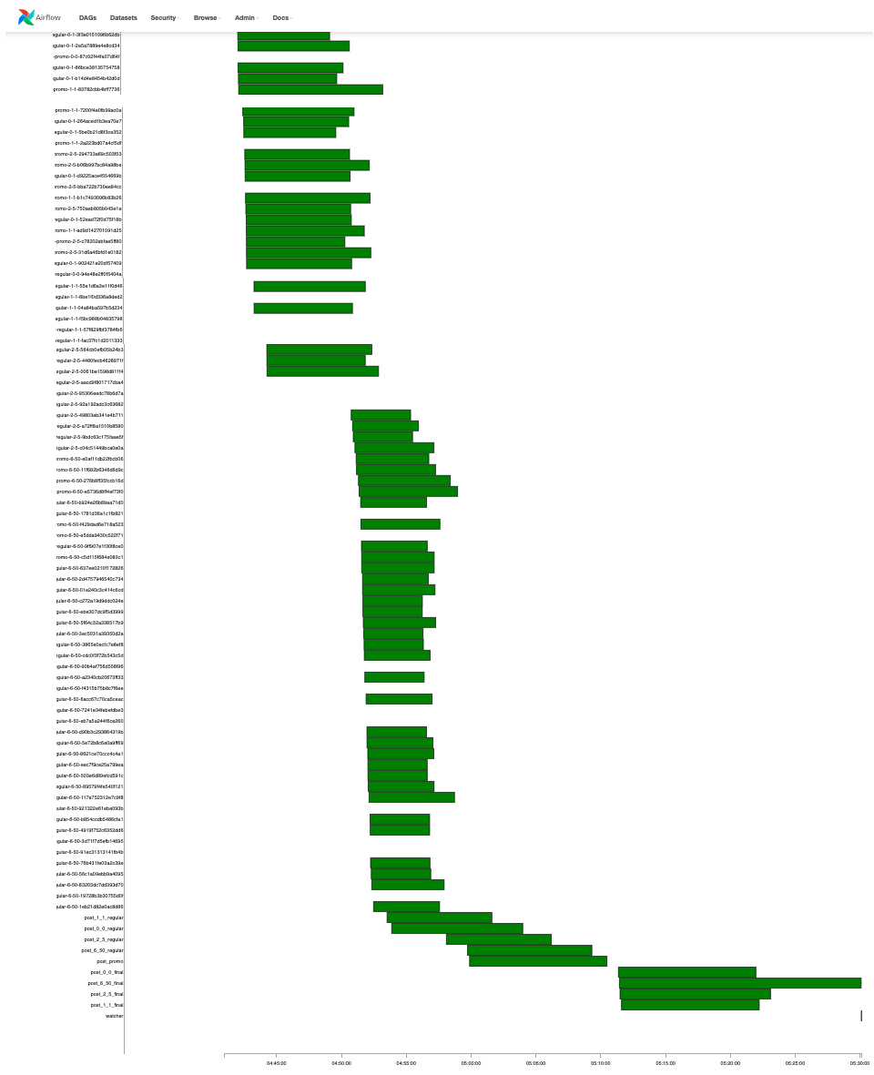
Gant view
Detailed task duration times
Bar size tells you how long a task takes to complete
Helps you to identify bottlenecks in your pipeline
Overlapping bars, means that the tasks are running in parallel

Slide 24
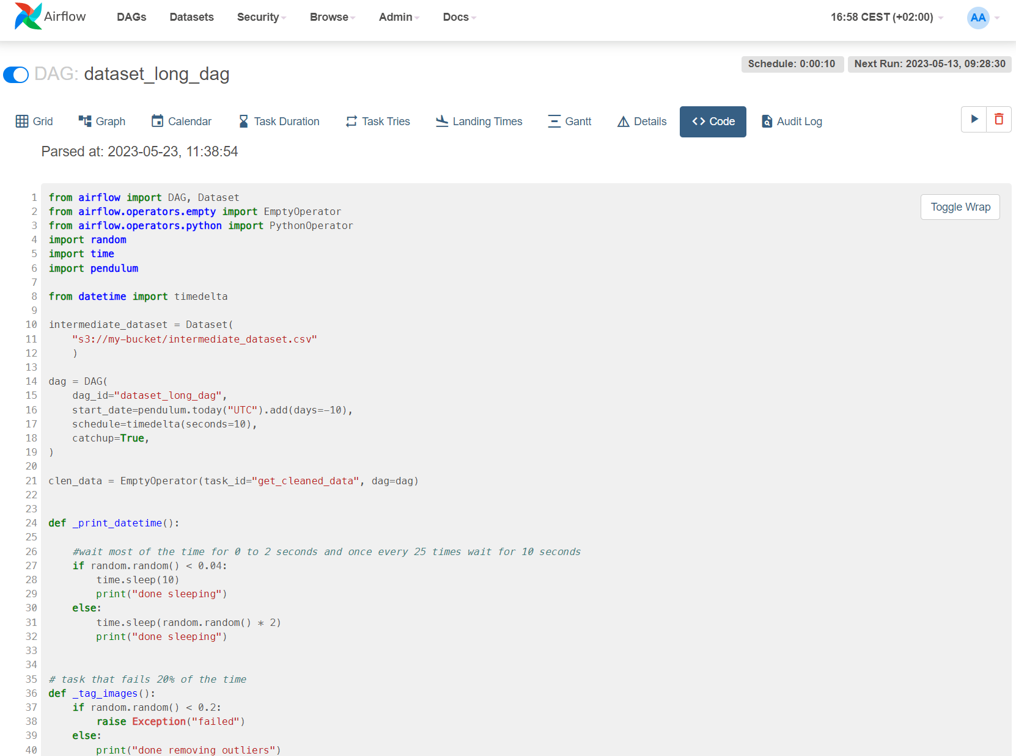
Code view
Displays the code of the data pipeline
Make sure that the latest code is running

Slide 25

Coding a DAG

Slide 26
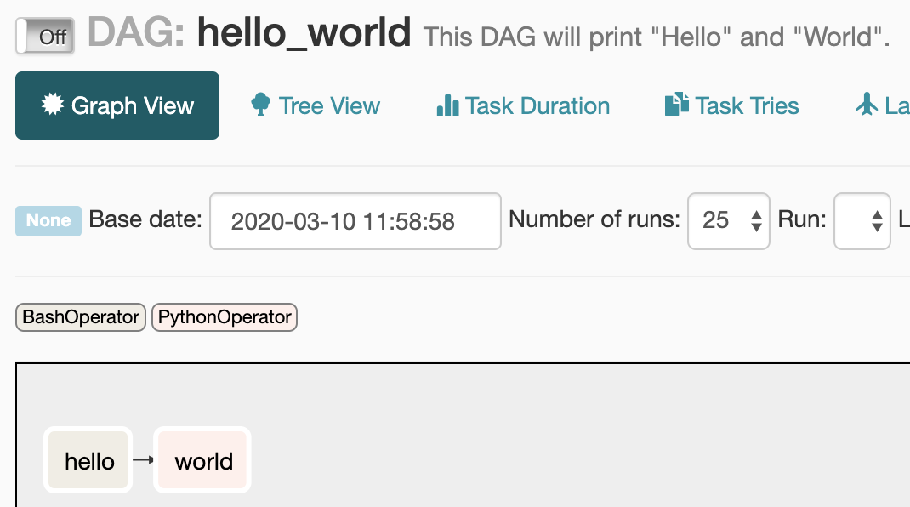
Create file called hello_world.py in dags/
Write the hello_world.py code
Wait 1-5 mins to pick up the new file
By default new DAGs are paused
A Dag in Python
from airflow.models import DAG
from airflow.operators.bash import BashOperator
from airflow.operators.python import PythonOperator
import pendulum
with DAG(
dag_id="hello_world",
start_date = pendulum.today('UTC').add(days=-14),
description='This DAG will print "Hello“ & "World".',
schedule="@daily",
):
hello = BashOperator(
task_id="hello",
bash_command="echo 'hello’”
)
world = PythonOperator(
task_id="world",
python_callable=lambda: print("world")
)
hello >> world
imports
Our DAG object
Tasks: hello and world
Operators: BashOperator and PythonOperator
Task dependencies
The DAG looks like this:
hello
world

Slide 27

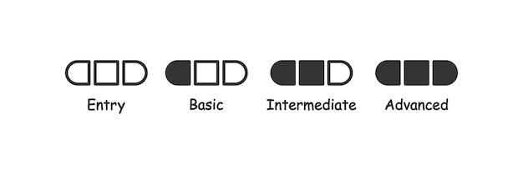
There are many ways to create a DAG
from airflow.models import DAG
from airflow.operators.bash import BashOperator
from airflow.operators.python import PythonOperator
import pendulum
dag = DAG(
dag_id="hello_world",
start_date = pendulum.today('UTC’),
schedule="@daily",
)
hello = BashOperator(
task_id="hello",
bash_command="echo 'hello’”,
dag=dag
)
def _hello_world():
print("world")
world = PythonOperator(
task_id="world",
python_callable = _hello_world,
dag=dag
)
hello >> world
from airflow.models import DAG
from airflow.operators.bash import BashOperator
from airflow.operators.python import PythonOperator
import pendulum
def _hello_world():
print("world")
with DAG(
dag_id="hello_world",
start_date = pendulum.today('UTC’),
schedule="@daily",
):
hello = BashOperator(
task_id="hello",
bash_command="echo 'hello’”
)
world = PythonOperator(
task_id="world",
python_callable= _hello_world
)
hello >> world
from airflow.models import DAG
from airflow.decorators import task
from airflow.operators.bash import BashOperator
from airflow.operators.python import PythonOperator
import pendulum
with DAG(
dag_id="hello_world",
start_date = pendulum.today('UTC’),
schedule="@daily",
):
hello = BashOperator(
task_id="hello",
bash_command="echo 'hello’”
)
@task
def world():
print("world")
hello >> world()

Slide 28

Changes in start_date
Airflow does no cope with well with start_date changes. It holds on to the first start_date you give it.
Ways to work around it:
Change the DAG name, this registers as a new DAG in Airflow
Manually backfill the missing DAG runs with "airflow backfill -s [start date] -e [end date] [DAG]“
Be Aware!
Changes in schedule
schedule="@daily"
schedule="@hourly"
Airflow also does not cope nicely with changing schedule
It will take the new schedule, starting from the last DAG run
With the new hourly interval, several DAG runs will be executed because the last run was at midnight

Slide 29
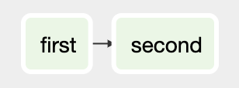
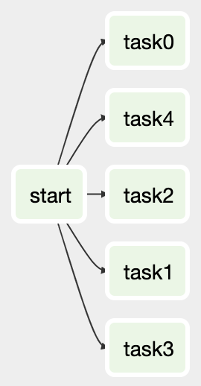
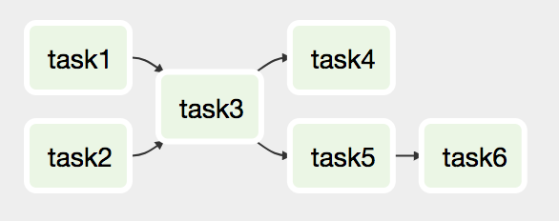
Task Dependencies
Our understandig of your request
One to many
Chaining tasks
Common way to set dependencies
t1 = EmptyOperator(task_id="task1", dag=dag) t2 = EmptyOperator(task_id="task2", dag=dag) t3 = EmptyOperator(task_id="task3", dag=dag) t4 = EmptyOperator(task_id="task4", dag=dag) t5 = EmptyOperator(task_id="task5", dag=dag) t6 = EmptyOperator(task_id="task6", dag=dag) [t1, t2] >> t3 >> t4 t3 >> t5 >> t6
start = EmptyOperator(task_id="start", dag=dag)
tasks = [EmptyOperator(task_id=f"task{i}", dag=dag) for i in range(5)]
start >> tasks
first >> second
or:
second << first

Slide 30
Exercise 1
Create a structure DAG for our launch?
You can use the EmptyOperator
from airflow.operators.empty import EmptyOperator
build_stage_1
procure_rocket _material
build_stage_2
launch
build_stage_3
procure_fuel

Slide 31

Time Scheduling

Slide 32
Schedule intervals
dag = DAG( dag_id="demo", start_date=datetime.datetime(2019, 1, 1), schedule="@daily", )

Slide 33
Schedule execution
Airflow starts execution at the END of an interval!

Slide 34
Schedule aliases
Alias | Meaning | Equivalent cron
None | No schedule, only for manual triggering
@once | Run only once
@hourly | 00:00 of each hour | 0 * * * *
@daily | 00:00:00 of each day | 0 0 * * *
@weekly | 00:00:00 every Sunday | 0 0 * * 0
@monthly | 00:00:00 of the first day of each month | 0 0 1 * *
@yearly | 00:00:00 on every January 1st | 0 0 1 1 *

Slide 35
Cron vs timedelta
We can set schedule intervals with cron, datetime.timedelta() and dateutil.relativedelta.relativedelta():
Cron | Equivalent timedelta/relativedelta
0 * * * * | datetime.timedelta(hours=1)
0 0 * * * | datetime.timedelta(days=1)
0 0 * * 0 | datetime.timedelta(weeks=1)
0 0 1 * * | dateutil.relativedelta(months=1)
0 0 1 1 * | dateutil.relativedelta(years=1)
Timedelta does not know >=months.

Slide 36
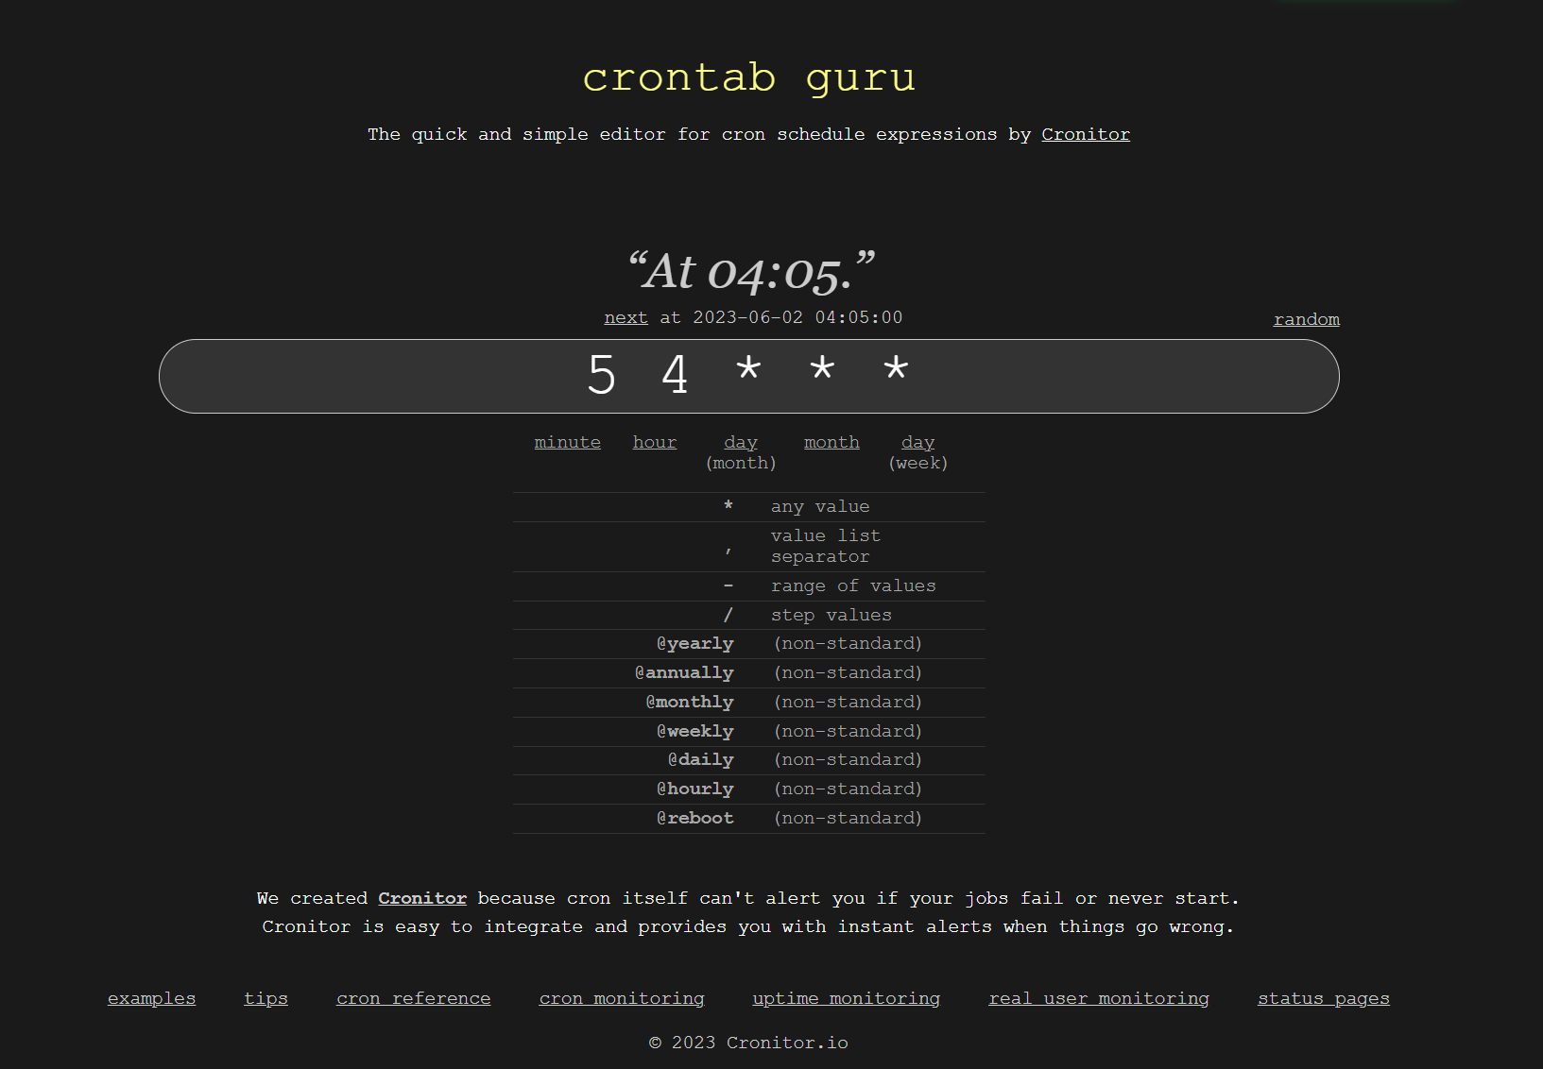
Are you good in cron?
If you are not, you can always make use of crontab.guru

Slide 37
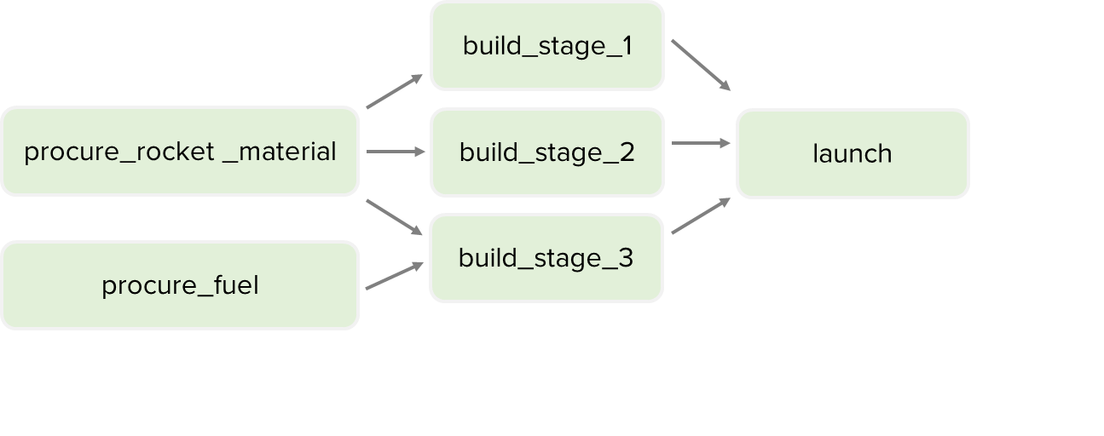
Exercise 2
From the previous exercise:
Try creating the following schedule intervals:
At 13:45 every Mon/Wed/Fri
Every 3 days
Starting 90 days ago
When to use cron or timedelta?

Slide 38

Airflow Context

Slide 39
The Airflow “context”
Airflow provides information about the execution in the Airflow task “context”.
This includes:
The (previous/next) execution_date of the DAG run
String formatted execution dates
The DAG object
Additional variables passed into the context (e.g. templates_dict)

Slide 40
What’s in the context?
def print_context(**context): pprint(context)
{'END_DATE': '2018-01-01',
'conf': <module 'airflow.configuration' from '/opt/conda/lib/python3.6/site-packages/airflow/configuration.py'>,
'dag': <DAG: templated_task_dag>,
'dag_run': None,
'ds': '2018-01-01',
'ds_nodash': '20180101',
'end_date': '2018-01-01',
'execution_date': <Pendulum [2018-01-01T00:00:00+00:00]>,
'inlets': [],
'latest_date': '2018-01-01',
'macros': <module 'airflow.macros' from '/opt/conda/lib/python3.6/site-packages/airflow/macros/__init__.py'>,
'next_ds': '2018-01-02',
'next_execution_date': datetime.datetime(2018, 1, 2, 0, 0, tzinfo=<TimezoneInfo [UTC, GMT, +00:00:00, STD]>),
'outlets': [],
'params': {},
'prev_ds': '2017-12-31',
'prev_execution_date': datetime.datetime(2017, 12, 31, 0, 0, tzinfo=<TimezoneInfo [UTC, GMT, +00:00:00, STD]>),
'run_id': None,
'tables': None,
'task': <Task(PythonOperator): demo_templating>,
'task_instance': <TaskInstance: templated_task_dag.demo_templating 2018-01-01T00:00:00+00:00 [None]>,
'task_instance_key_str': 'templated_task_dag__demo_templating__20180101',
'templates_dict': None,
'test_mode': True,
'ti': <TaskInstance: templated_task_dag.demo_templating 2018-01-01T00:00:00+00:00 [None]>,
'tomorrow_ds': '2018-01-02',
'tomorrow_ds_nodash': '20180102',
'ts': '2018-01-01T00:00:00+00:00',
'ts_nodash': '20180101T000000+0000',
'var': {'json': None, 'value': None},
'yesterday_ds': '2017-12-31',
'yesterday_ds_nodash': '20171231’
}

Slide 41
PythonOperator vs all other operators
In all operators, arguments are templated strings
The PythonOperator takes code, which is therefore templated differently
print_exec_date = BashOperator( task_id="demo_templating", bash_command="echo {{ execution_date }}" )
def _print_exec_date(): print("{{ execution_date }}")
This does not work
def _print_exec_date(**context): print(context["execution_date"])
This does work
print_exec_date = PythonOperator( task_id="demo_templating", python_callable=_print_exec_date, )

Slide 42
python_callable vs templates_dict
Python callable takes code
The values in templates_dict are templated strings
def _print_exec_date(**context): print(context[“templates_dict"][”execution_date”])
print_exec_date = PythonOperator( task_id="demo_templating", python_callable=_print_exec_date, provide_context=True, templates_dict={
“execution_date”: “{{ execution_date }}”
}, )

Slide 43
Exercise 3
Let’s familiarize with the context
Echo the following messages with the bash operator:
“[task] is running in the [dag] pipeline”
Print the following messages with the python operator:
“This script was executed at [date]”
“Three days after execution is [date]”
“This script run date is [date]”

Slide 44

Sensors

Slide 45

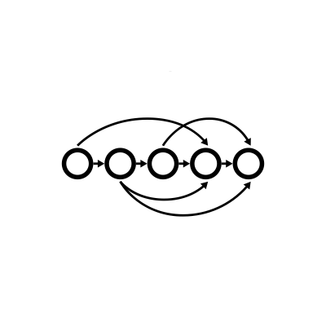
Sensors
Poll for a certain condition to be True
Airflow sensor
13:01 check data? No
13:02 check data? No
13:03 check data? No
13:04 check data? No
13:05 check data? No
13:06 check data? Yes
External data uploaded somewhere between 13:00 and 17:00
FTP
from airflow.contrib.sensors.ftp_sensor import FTPSensor wait_for_data = FTPSensor( task_id="wait_for_data", path="foobar.json", ftp_conn_id="bob_ftp", )

Slide 46

Sensors
Implement your own condition PythonSensor
from datetime import datetime from airflow.sensors.python import PythonSensor def _time_for_coffee(): """I drink coffee between 6 and 12""" if 6 < datetime.now().hour < 12: return True else: return False time_for_coffee = PythonSensor( task_id="time_for_coffee", python_callable=_time_for_coffee, mode="reschedule", )

Slide 47
Sensors
The sensor deadlock
Always set mode=“reschedule”
Airflow queues tasks in slots
The (default!) “poke” mode holds the slot while waiting for the next poke
With (default) parallelism 32, and 32 sensors, your system has no more free slots to do actual work
Therefore set mode=“reschedule”. This releases the slot and claims a new one for every Sensor poke.

Slide 48
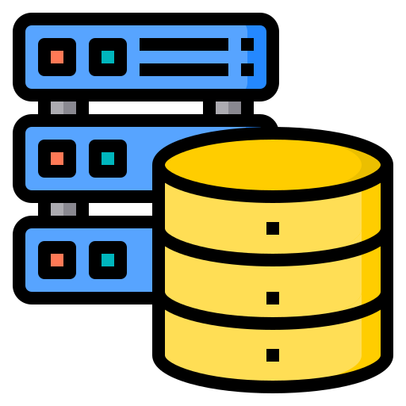
Airflow Metastore
XComs, Variables & Connections

Slide 49
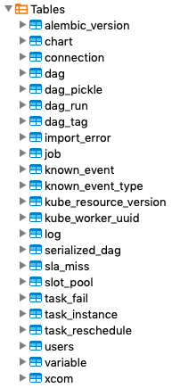
Storing data in the metastore
Most tables are internal to Airflow
Users can store information in:
Connections
Variables
XComs
IF you want to sneak around:
docker ps
docker exec -it <db-postgres name> /bin/bash
psql -Uairflow
SELECT * FROM information_schema.tables;
SELECT * FROM xcom;

Slide 50
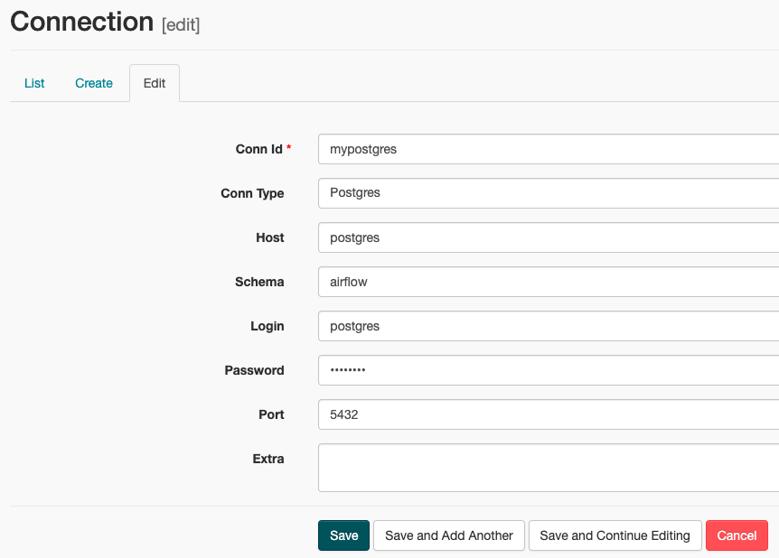
Connections
Connection credentials can be stored in the Airflow database
Configures a Fernet key for encryption in the configuration
https://airflow.apache.org/docs/stable/howto/secure-connections.html

Slide 51
Connections - Example
import airflow.utils.dates from airflow.hooks.base_hook import BaseHook from airflow.models import DAG from airflow.operators.python_operator import PythonOperator dag = DAG(...) def _fetch_data():
conn = BaseHook.get_connection("my_database") username = conn.login password = conn.password ... push = PythonOperator(task_id="fetch_data", python_callable=_fetch_data, dag=dag)

Slide 52
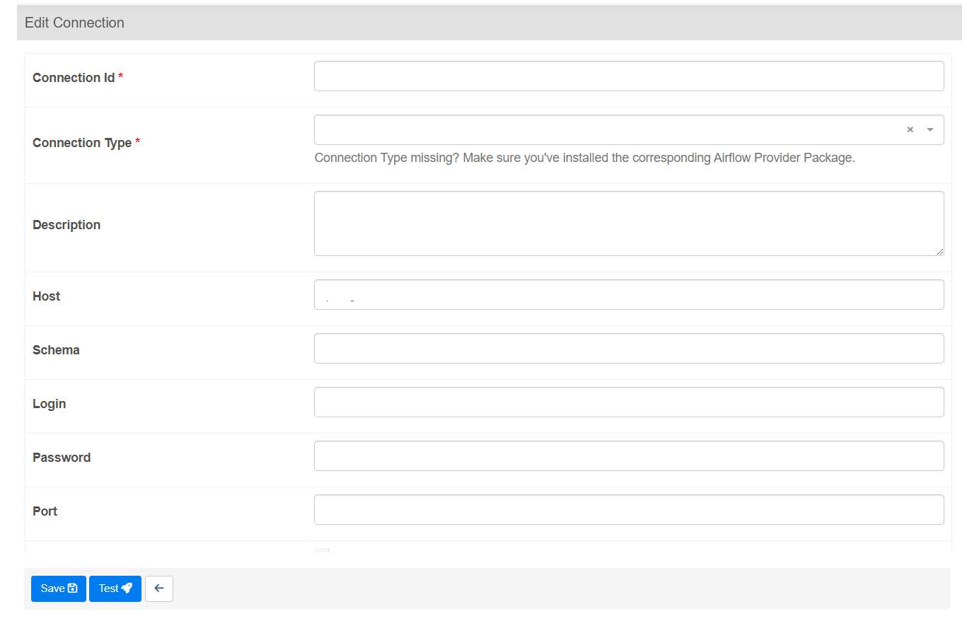
Let’s Define two connections
Will be useful for later
Airflow Postgres DB
The Space Devs API
postgres
thespacedevs_dev
postgres
HTTP
postgres
https://lldev.thespacedevs.com/2.2.0/
airflow
airflow
5432
This connection will allow us to connect to the Airflow Internal Postgres DB
Will allow us to make calls to the Rocket launches API

Slide 53
Hooks
Used to interact with (external) systems/service
Usually created behind the scenes by the respective operators
Abstract away logic of interacting with systems
Handles authentication, caching, pagination, etc.
Some examples
S3Hook – Upload/download files to/from S3
SSHHook – Upload/download files over SFTP
SparkSubmitHook – Send jobs to Spark cluster

Slide 54
Hooks - Example
from airflow.hooks.postgres_hook
hook = PostgresHook(
postgres_conn_id="land_registry”
)
hook.get_records(
"SELECT * FROM land_registry_price_paid_uk "
"LIMIT 10”
)

Slide 55
Variables
Can be used as “global” variables
Stored as key-value pairs
Also accessible in templating:
from airflow.models import Variable
Variable.get("myvar", deserialize_json=True, default_var=dict())
Variable.set("myvar", value, serialize_json=True)
"{{ var.json.myvar }}"
"{{ var.value.myvar }}"

Slide 56
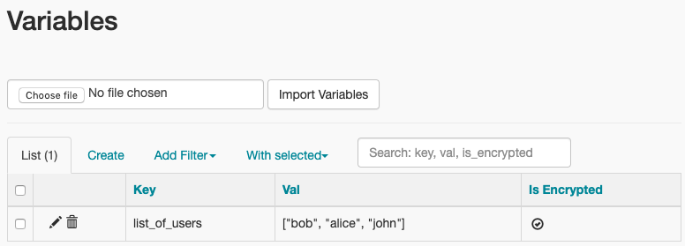
Variables - Example
import airflow.utils.dates from airflow.models import DAG, Variable from airflow.operators.python_operator import PythonOperator dag = DAG( dag_id="example_variable",
start_date=airflow.utils.dates.days_ago(3), schedule=None, ) def _email_users(): users = Variable.get("list_of_users", deserialize_json=True) for user in users: ... email_users = PythonOperator(task_id="email_users", python_callable=_email_users, dag=dag)

Slide 57
XComs (aka Cross-Communication)
Useful when you want to share data between tasks
XComs are meant for sharing (small) pieces of information
No max size enforced right now
Possibly coming in Airflow 2.1
SQLite: BLOB type (max 2GB)
PostgreSQL: BYTEA type (max 1GB)
MySQL: BLOB type (max 64KB)
XComs for task-to-task communication, Variables for “global”
Note: does not work between instances of the same task! (e.g. when using reschedulable sensors)

Slide 58
XComs
Small data?
XCom push
XCom pull
task1
File size
{“result”: [1,2,3]}
task2
Large data?
Write file
Read file
Filesystem

Slide 59
Xcoms - Example
import random import airflow.utils.dates from airflow.models import DAG from airflow.operators.python import PythonOperator
def _push(task_instance, **_): teammembers = ["Bob", "John", "Alice"] result = random.choice(teammembers) task_instance.xcom_push(key="person_to_email", value=result) return result def _pull(task_instance, **_): result_by_key = task_instance.xcom_pull(task_ids="push", key="person_to_email") result_by_return_value = task_instance.xcom_pull(task_ids="push") print(f"Email {result_by_return_value}") print(f"Email {result_by_key}")
with DAG(dag_id="example_xcom", start_date=airflow.utils.dates.days_ago(3), schedule="@daily"): push = PythonOperator(task_id="push", python_callable=_push, provide_context=True) pull = PythonOperator(task_id="pull", python_callable=_pull, provide_context=True) push >> pull
XCom via
explicit push
XCom via
return value

Slide 60
Xcoms – Default Behavior
The BaseOperator holds an argument do_xcom_push (default True)
If do_xcom_push and a value is returned, it is automatically pushed into the XCom table
If no key is supplied during push/pull, a default key with value “return_key” is set

Slide 61
Capstone Project!
We start launching rockets
As a Rocket Scientist your manager asked you to have a good overview of the days a rocket launch has been made. And get insights about the launches.
You can get the full instructions in the Capstone Project file in the sharepoint folder.

Slide 62


Branching & Trigger rules

Slide 63
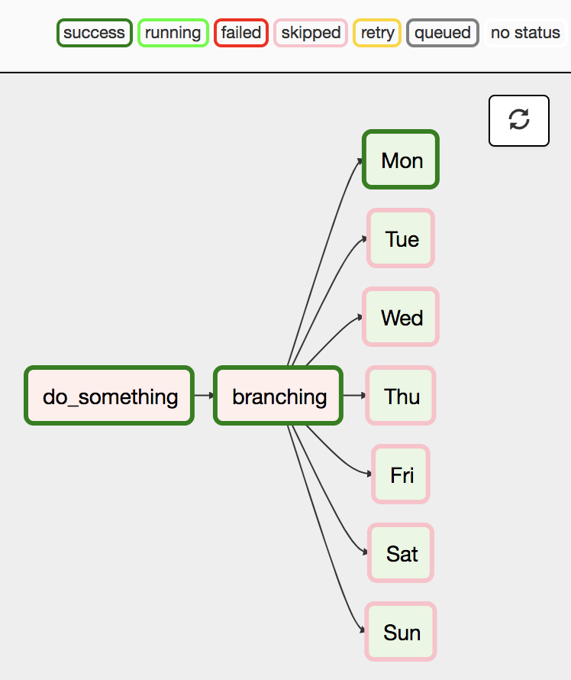
PythonOperator vs all other operators
Sometimes you’d like to execute some tasks based on a specific condition
Examples:
Running tasks on certain days of the week
Running a different set of tasks after a specific date (e.g. to account for a schema change)

Slide 64
The PythonBranchOperator
Branches on a certain condition
Accepts a callable, which when called should return the name of downstream task(s) to run
Other tasks are automatically skipped
Note that tasks should be a (direct) downstream dependency of the branch task

Slide 65
The PythonBranchOperator
def _get_weekday(execution_date, **context): return execution_date.strftime("%a") # “Mon”
branching = BranchPythonOperator( task_id="branching",
python_callable=_get_weekday, ) days = ["Mon", "Tue", "Wed", "Thu", "Fri", "Sat", "Sun"] for day in days: branching >> DummyOperator(task_id=day)

Slide 66
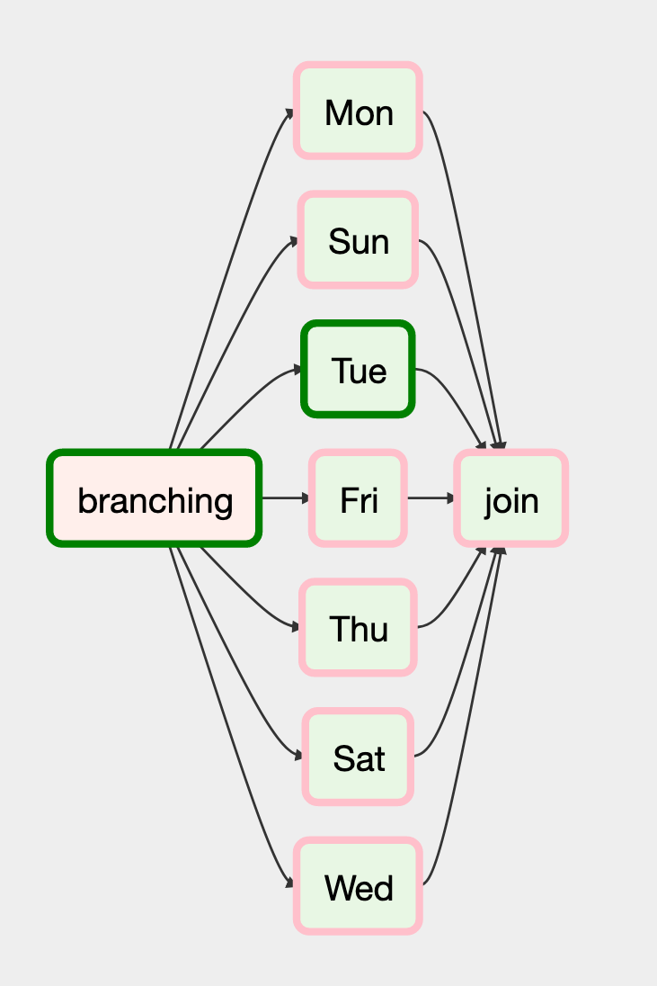
Continuing after a branch
Typically, execution after a branch is continued after a (dummy) join task
This allows downstream tasks to be ‘unaware’ of the branch
However, naively adding a join does not work. Any idea why?

Slide 67
Trigger rules
Trigger rules determine when a task is executed
Defined using the trigger_rule Operator argument
Default rule is all_success (all upstream tasks must have completed successfully)
TriggerRule.ALL_SUCCESS | (Default) all parents have succeeded.
TriggerRule.ALL_FAILED | All parents are in a failed or upstream_failed state.
TriggerRule.ALL_DONE | All parents are done with their execution.
TriggerRule.ONE_FAILED | Fires as soon as at least one parent has failed, it does not wait for all parents to be done.
TriggerRule.ONE_SUCCESS | Fires as soon as at least one parent succeeds, it does not wait for all parents to be done.
TriggerRule.DUMMY | Dependencies are just for show, trigger at will.

Slide 68
Fixing the join
Changing the trigger rule is enough:
Ensures join will run if none of the upstream tasks fail
join = EmptyOperator(
task_id="join",
trigger_rule="none_failed"
)

Slide 69


Backfilling

Slide 70
Backfilling
Backfilling is the concept of (re-)running Airflow tasks back in time.
For example:
You created a daily job and want to run it 1 year back.
A task failed due to a missing file. You placed the file manually and now you want to re-run the task.
You changed code in a DAG and want to re-run specific tasks with the changed code.

Slide 71
Backfilling
As mentioned before: Airflow doesn’t like to re-run task before the start_date.
Backfilling is possible via:
Run docker compose ps and find the name of the scheduler
Get into the scheduler via:
docker exec -it <scheduler name> /bin/bash
3. Run:
airflow dags backfill -s 2023-04-01 -e 2023-04-30 <dag_name>

Slide 72
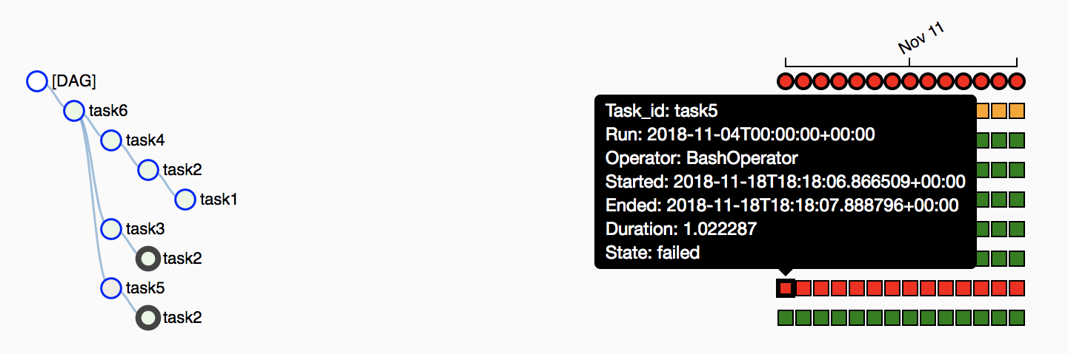
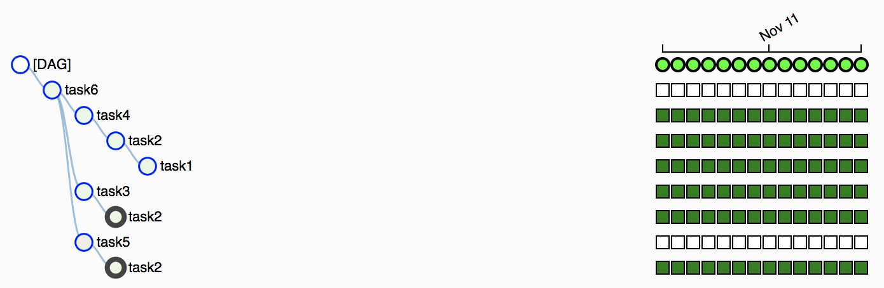
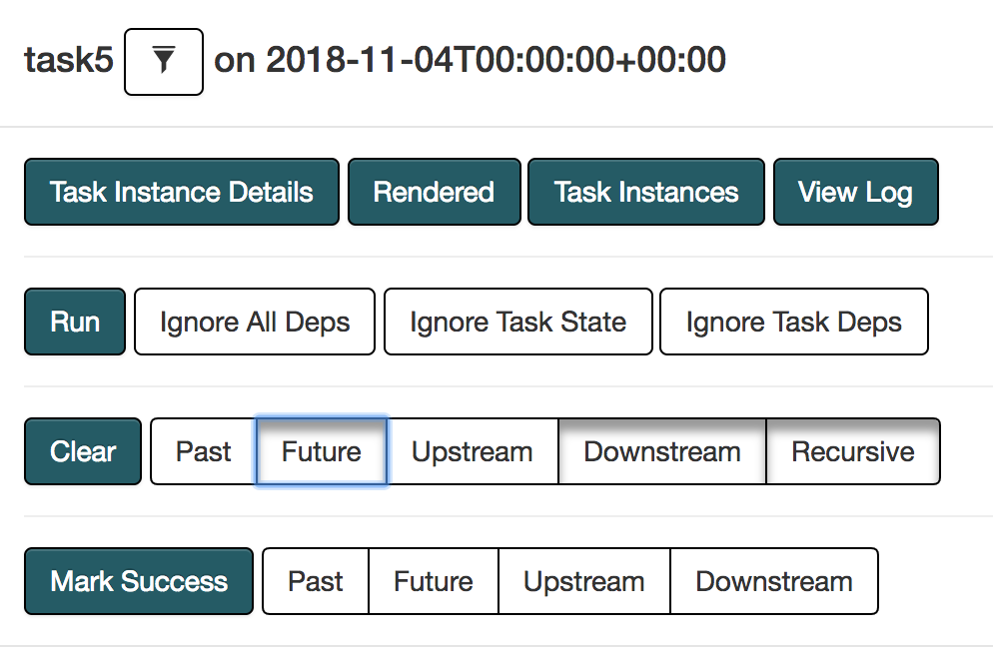
Clear Tasks
You can clear one or many task depending on selection criteria.
Only the ones that failed
Task in the Future
Upstream Downstream
All
Airflow will rerun those tasks

Slide 73
Designing tasks for backfilling
Tasks should be atomic and idempotent
Atomic
Tasks either succeed fully or not at all (no partial result)
Idempotent
Re-running a task gives the same result
(Assuming other circumstances have not changed)

Slide 74
Dataset
Data-aware DAG triggers

Slide 75
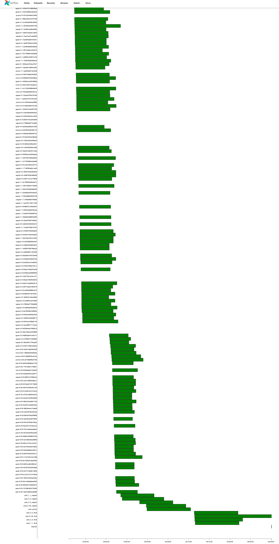
Some DAG’s are really loooooooong?
Can we do something better?
Dag 1
Maybe we can break them in smaller chunks
But then how do you trigger one after another?
Dag 2
Dag 3
Dag 4

Slide 76

How do make your DAGs data-aware?
Let's focus on a use case.
Team A: Fetch for External sources
Team B: Produces a Report
DAG 1
DAG 2
Fetch Raw Data
Remove Outliers
Update Database
(if needed)
Fetch transformed data
Produces
Alert & Insights

Slide 77
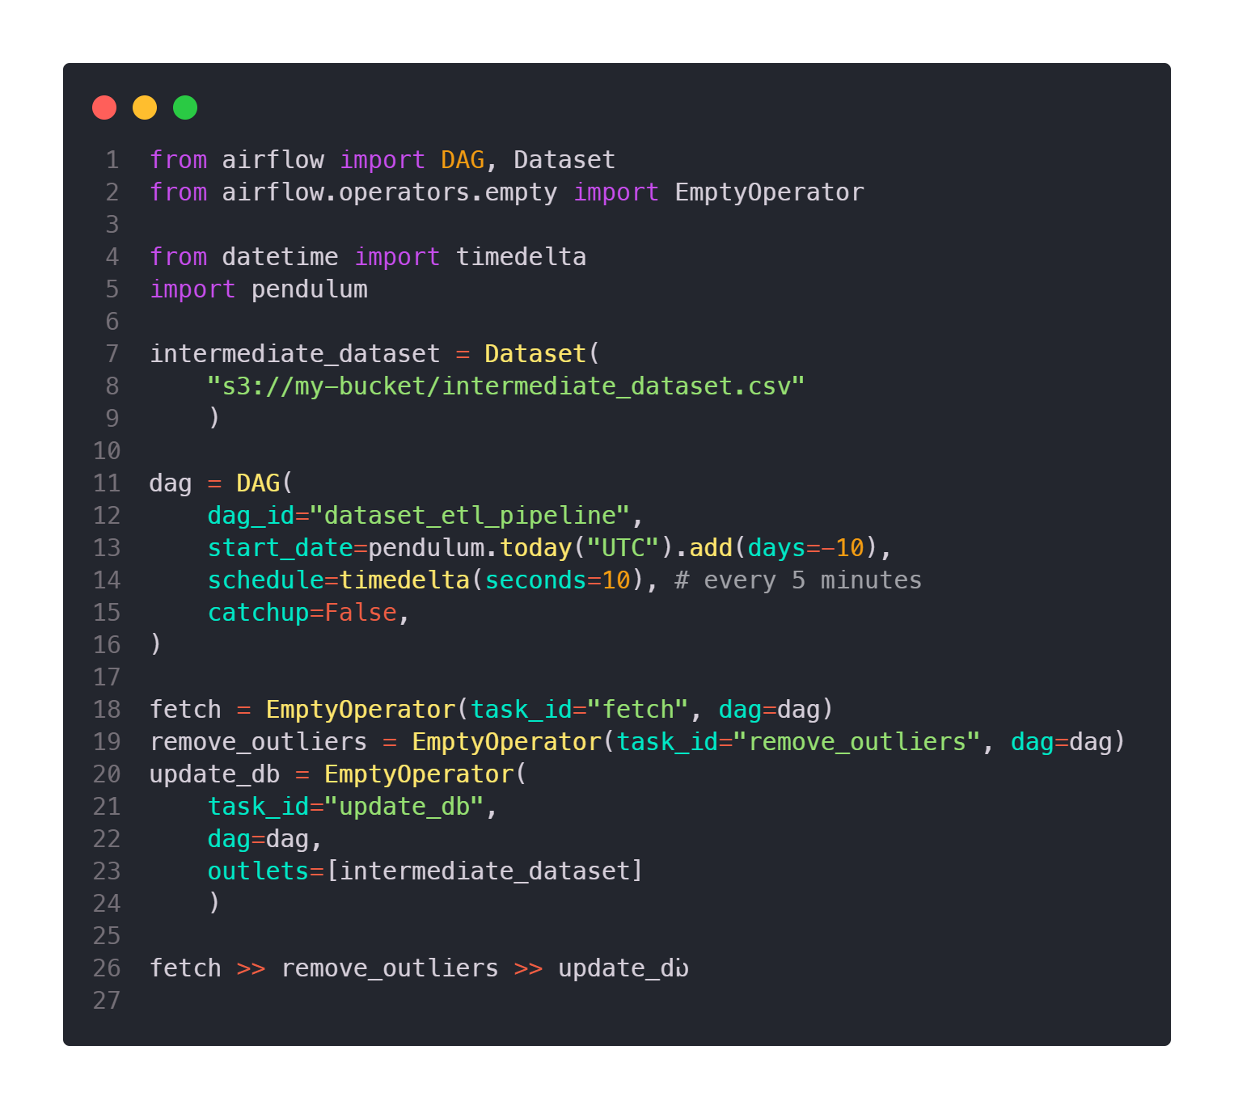
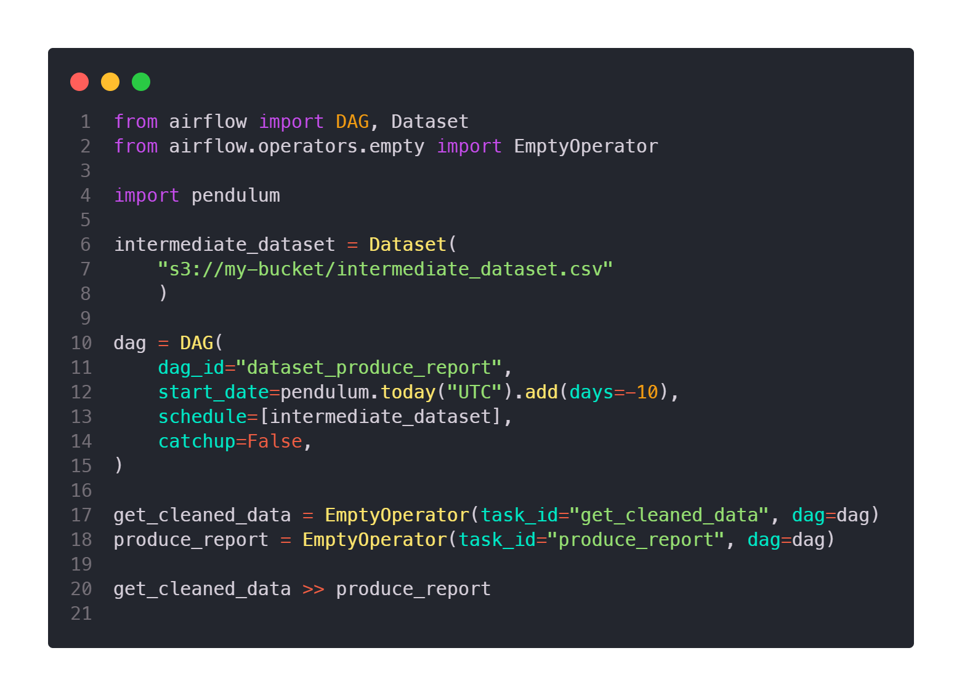



Meet the Dataset…
source.py
Consumer.py
_URI_
You can list multiple files. Will be triggered when all files are updated
Intermediate
dataset
DAG 1
DAG 2
Source
Consumer
New feature in Airflow ≥ 2.4
schedule replaces schedule_interval providing more flexibility on DAG trigger

Slide 78
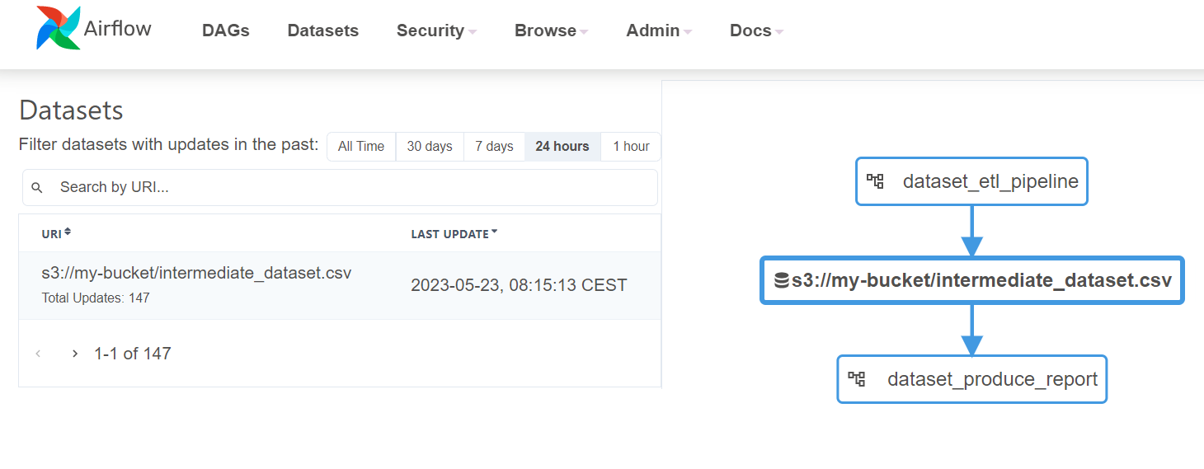
A Dataset change becomes a trigger!

Slide 79
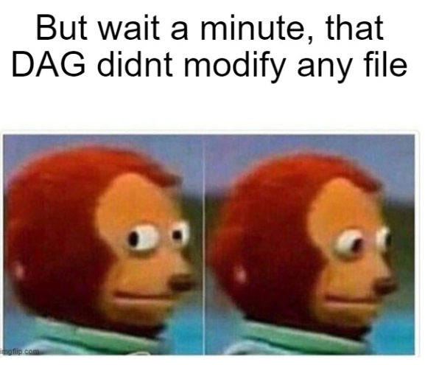
Dataset quirks…
Airflow doesn’t verify the data has been changed. It only verifies if the source DAG has executed correctly.
Dataset URI acts as a Link / tag to create triggers.
If two tasks update the same dataset, the Consumer DAG triggers after the first task completes.
Schedules cannot be combined (datasets and cron expressions).
Airflow only monitors datasets within DAGs, not external modifications, or DAGs on External Instances.

Slide 80
Exercise: The Dataset
Modify two of your previous DAG’s to be a consumer and a producer.
The producer DAG should trigger every 10 seconds
The consumer DAG should trigger each time the producer DAG finish a run.
Tip: Don’t worry too much about actually storing/changing any data

Slide 81

Let us know what you think!
https://xebia-academy.my.salesforce-sites.com/apex/selectsurvey

